Slide 1
Solar Power Generation Prediction
A Data Science Project | Machine Learning & Deployment
Institution: AI Variant
Date:24-04-2025

Slide 2
Project by:
Mentor :- Bapuram pallavi & Neha Ramchandani
Candidates:-
1) BHANU TEJA L
2) C Binu Krishna
3) C M Rithika
4) KARTHIK ND
5) Mishael Vinod Sathe
6) Rushikesh Vilas Garade
7) Vurvesh kale

Slide 3
Introduction & Business Problem
Objective: Predict solar power generation based on environmental conditions.
Why it matters: Accurate prediction helps in energy planning, grid optimization, and renewable energy investment decisions.
Problem Type: Regression — the target variable “power_generated” is continuous

Slide 4
Dataset Overview
Rows: 2920
Features: 9 independent variables
Target: power_generated
Key features:
Distance to Solar Noon
Temperature
Wind Direction & Speed
Sky Cover
Visibility
Humidity
Avg Wind Speed (Period)
Avg Pressure (Period)

Slide 5
Exploratory Data Analysis (EDA)
Performed data visualization, checked missing values, analyzed distributions, and examined feature correlations to understand churn patterns.
Loaded the dataset and provided a summary.
Checked for missing values, data distribution, and outliers.
Visualized relationships between key variables and power generated.
Plotted a correlation matrix to identify high-impact features
Observed that temperature and sky cover are strongly correlated with power output.
Detected a few outliers in wind-related variables and average pressure

Slide 6
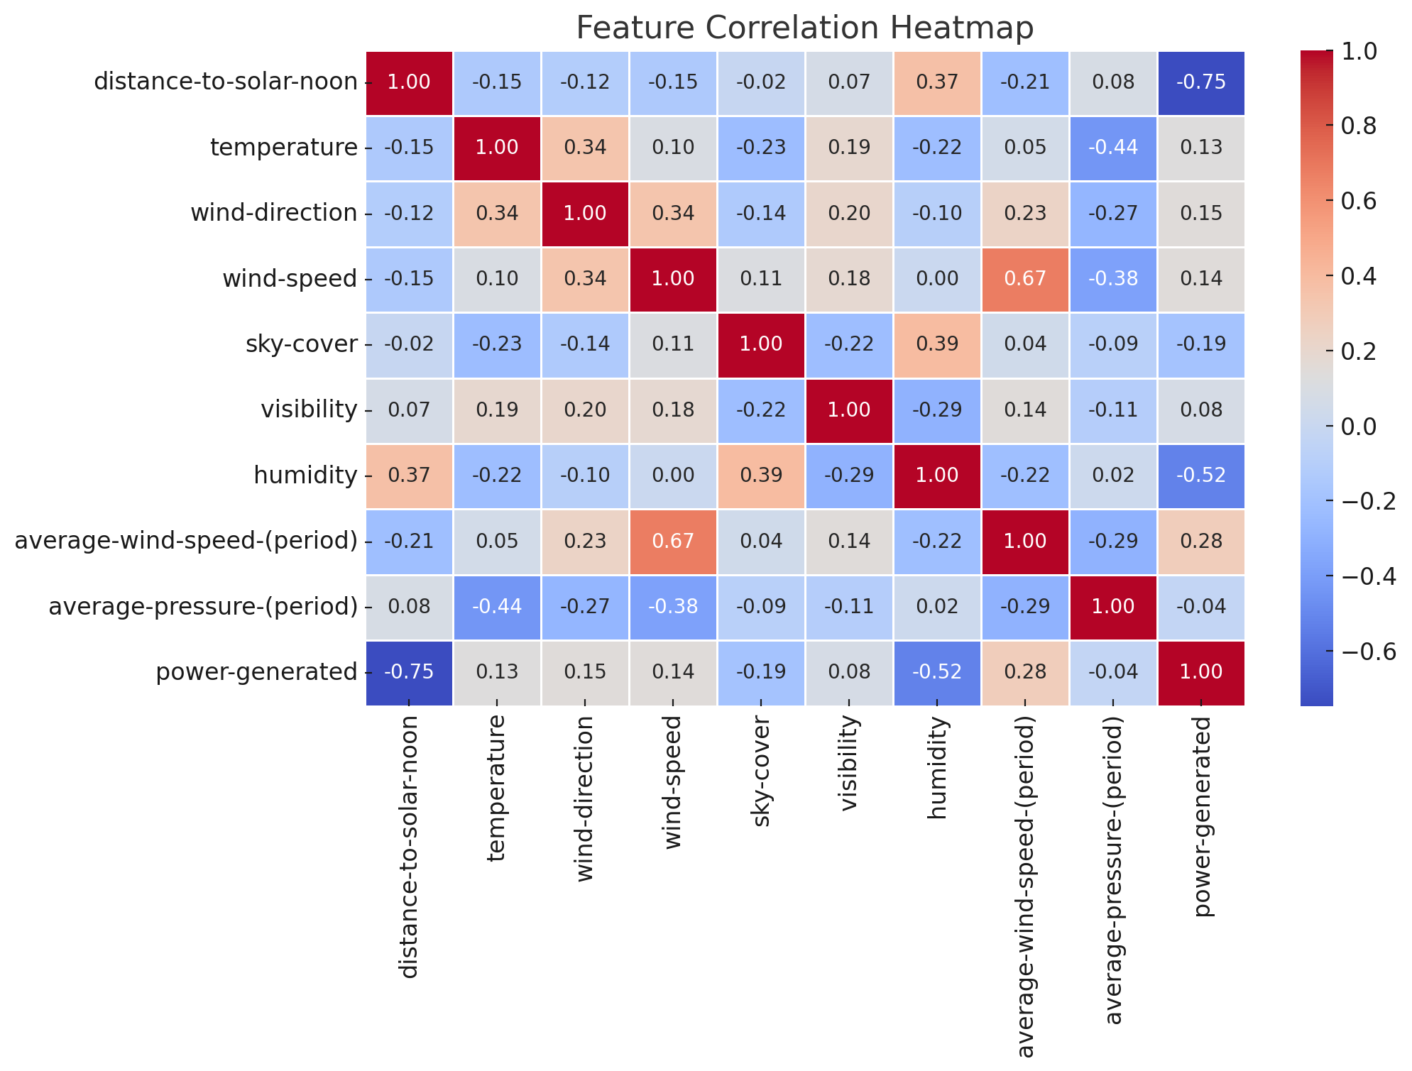
Visualization
Correlation Matrix(Heat map)
Fig 1: Correlation matrix shows relationships between variables.

Slide 7
• Distance-to-solar-noon has a moderate positive correlation with power-generated (as expected, since solar power peaks around noon). • sky-cover and humidity have negative correlations with power-generated, indicating cloudier, humid days reduce power generation. • wind-speed and average-wind-speed-(period) are correlated but not strongly linked to power generated.
Correlation Analysis:

Slide 8
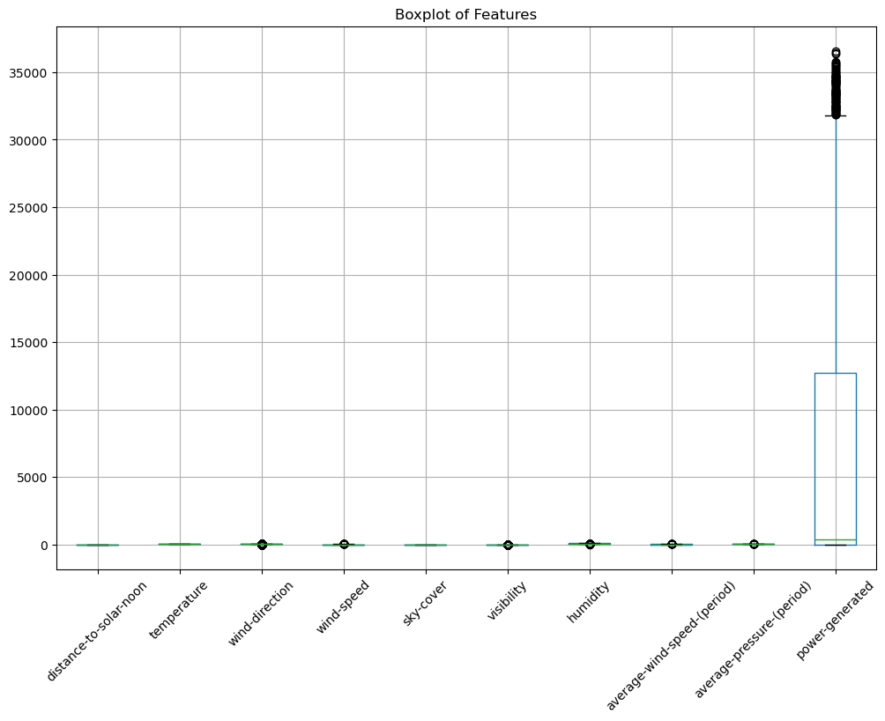
Boxplot
Fig 2: Boxplot indicates Outliers

Slide 9
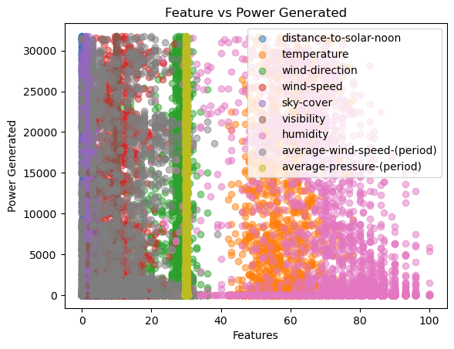
Scatter Plot
Fig 3: Understanding of dependence b/w feature & target variable.

Slide 10
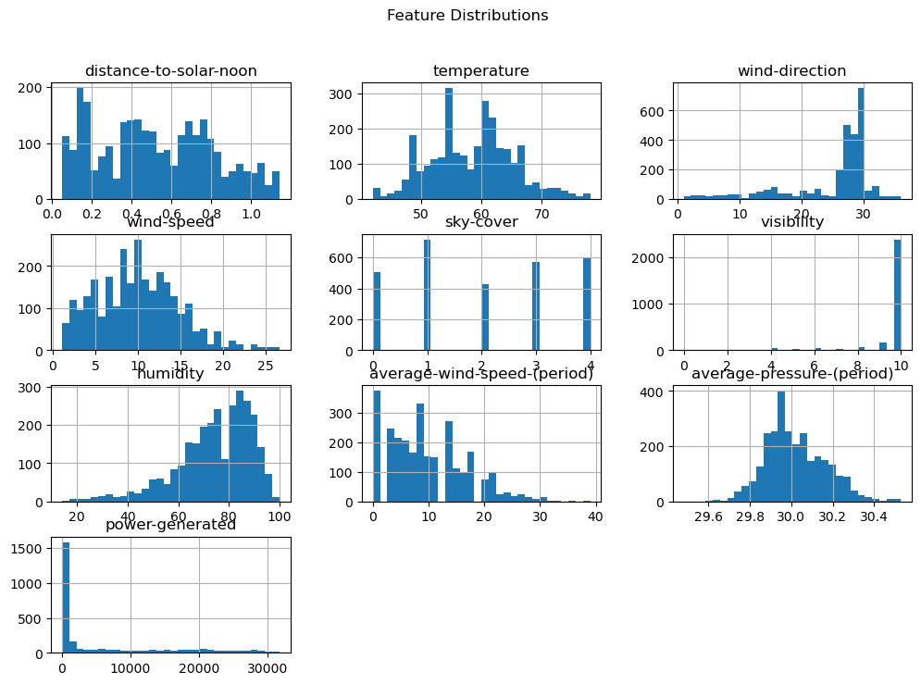
Histograms
Fig 4: It helps in knowing how data is distributed under each variable.

Slide 11
Feature Engineering
.
Converted categorical variables, scaled numerical features, and selected important features for training the model.
Encoded categorical variables.
Standardized numerical features using StandardScaler.
Selected relevant features.
Renamed columns for consistency.

Slide 12
Model Building
Tested multiple models (Logistic Regression, Random Forest, etc.), and selected the best model based on performance metrics.
Trained multiple models (Logistic Regression, Random Forest, etc.).
Tuned hyperparameters and selected the best-performing model.
Saved the final model as reg.pkl using pickle

Slide 13


Model Selection
Random Forest is an ensemble machine learning algorithm that builds multiple decision trees and combines their outputs to improve accuracy and reduce overfitting. It’s used for both classification and regression tasks.
Linear Regression is a statistical method used to model the relationship between a dependent variable and one or more independent variables by fitting a straight line through the data points. The line predicts the output based on input values.
Fig 5: Model comparison to find better model based on performance

Slide 14

Model Selection
K-Nearest Neighbors (KNN) is a simple, non-parametric algorithm used for classification and regression. It works by finding the K closest data points to a new input and predicting the output based on the majority or average of those neighbors.
Fig 5: Model comparison to find better model based on performance

Slide 15
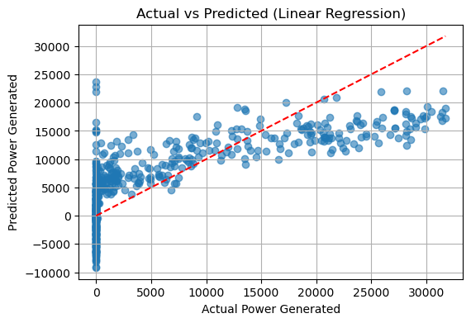
Model Evaluation
Evaluated models using RMSE(root mean squared error) and MAE(Mean Absolute Error) and r2 score
Fig 6: Comparison between actual & prediction of power generation.

Slide 16
Model Deployment
Developed an interactive Streamlit app allowing users to input details and predict solar prediction probability.
Built an interactive UI for solar power prediction.
Allowed users to input details and Deployed an app using stream lit community cloud with GitHub.

Slide 17
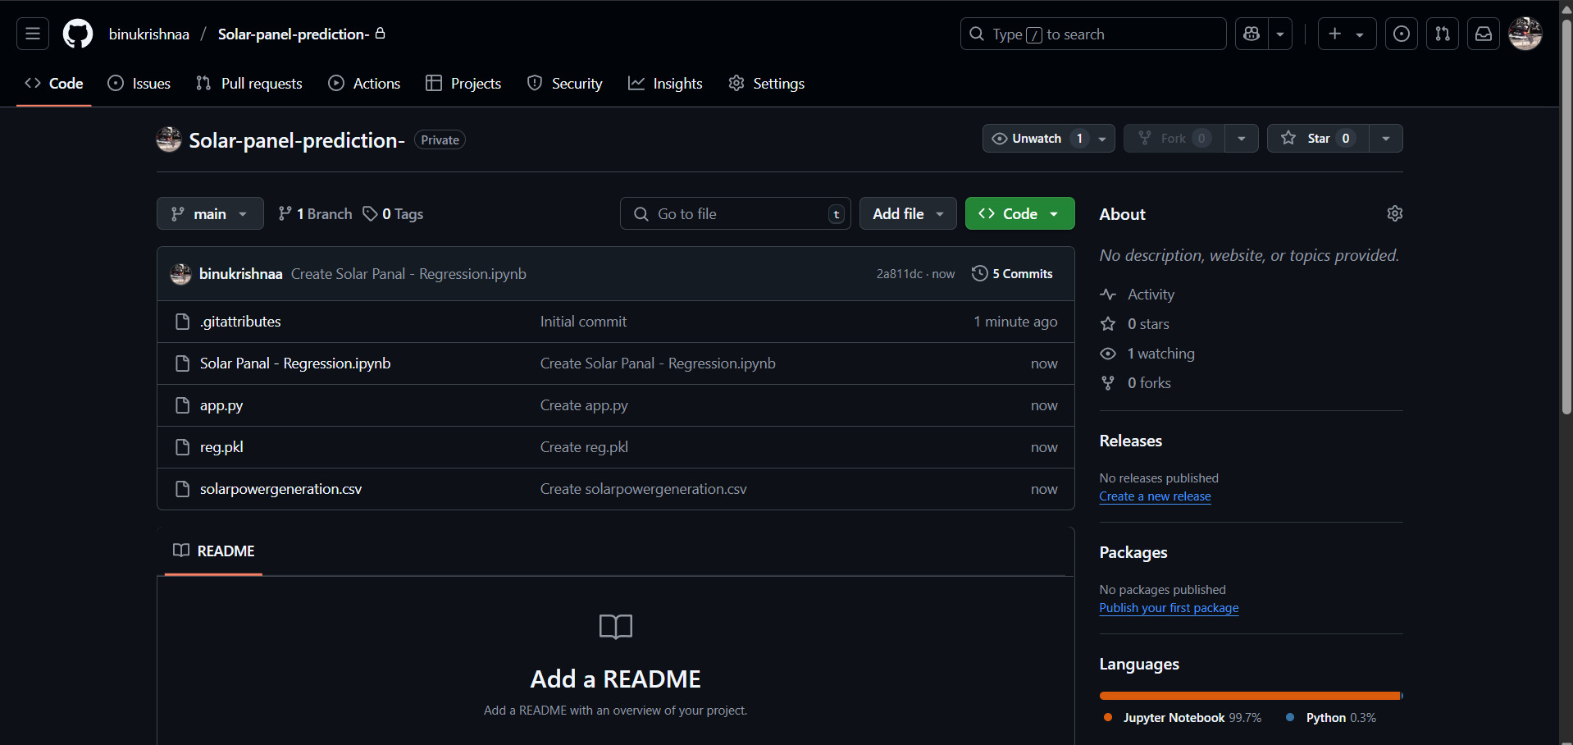
Fig 7: View of deployment in GitHub

Slide 18
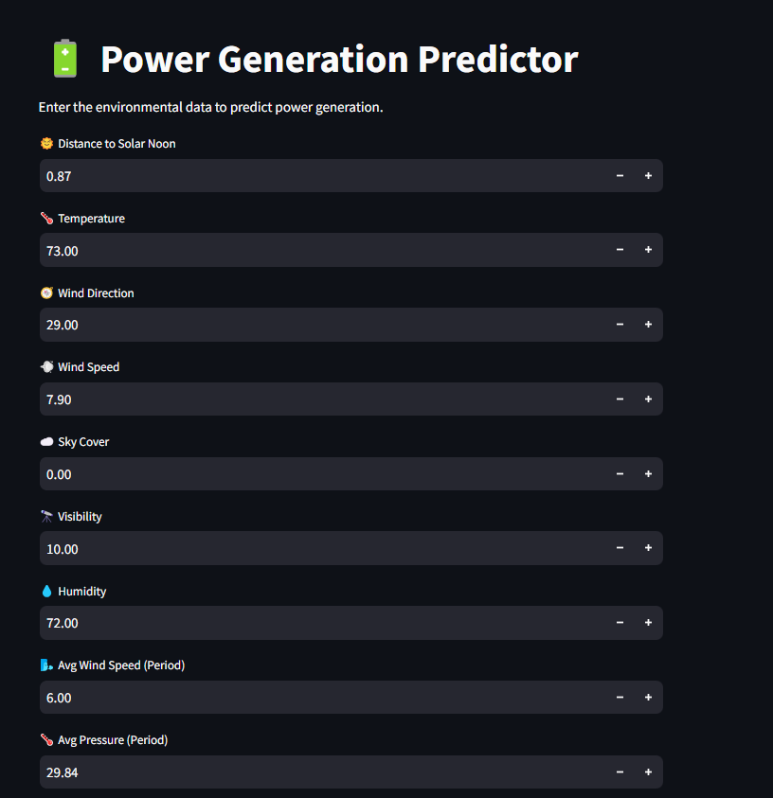
Fig 8: Power prediction with zero units

Slide 19
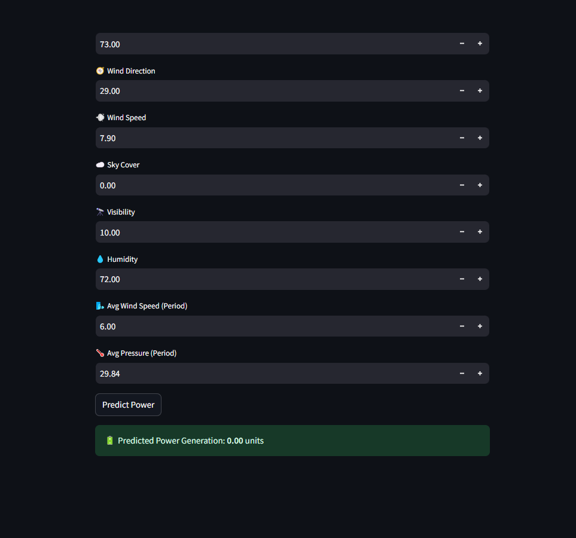
Fig 9: Power prediction with zero units

Slide 20
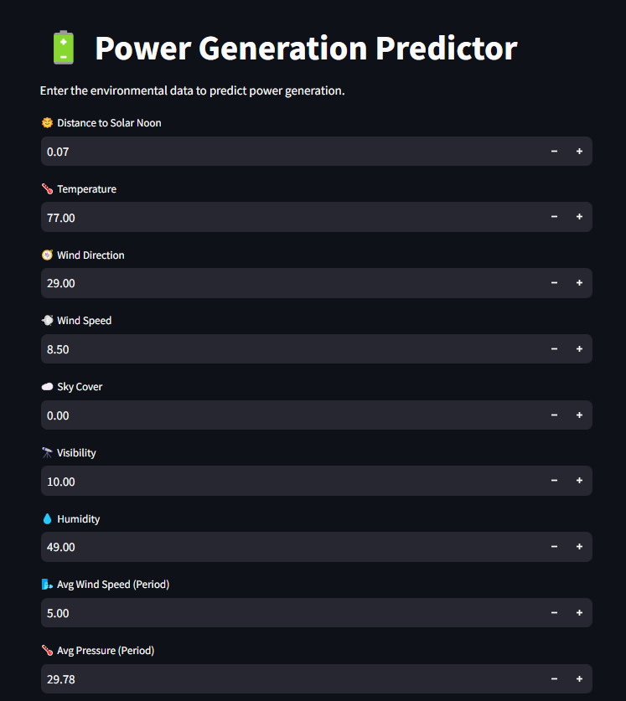
Fig 10: Power prediction with units

Slide 21
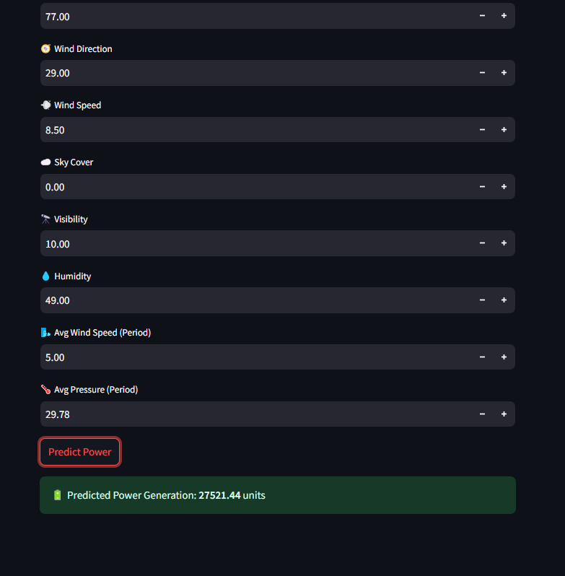
Fig 11: Power prediction with units

Slide 22
Challenges Faced During Project
Column renaming mismatch caused prediction errors
Handling data preprocessing for regression
Integrating model with Stream lit UI
Initial issue with PowerShell virtual environment activation

Slide 23
Conclusion and Future Scope
Conclusion:
Power Generation Predicted: Power generation was successfully predicted using regression techniques, demonstrating accurate forecasting capabilities.
User-Friendly App: A simple and interactive Streamlit app was developed, enabling users to make real time power generation predictions with ease.

Slide 24
Future Scope:
Trend Visualization: Add historical power generation trends.
Online Deployment: Deploy app on Streamlit Cloud or HuggingFace.
Real-Time Data: Retrain with live weather data for better accuracy.

Slide 25
THANK YOU

